Slide 1
JNCIS-ENT
Open Shortest Path First (OSPF)

Slide 2
The Link-State Database
1
An overview of OSPF and the LSDB

Slide 3
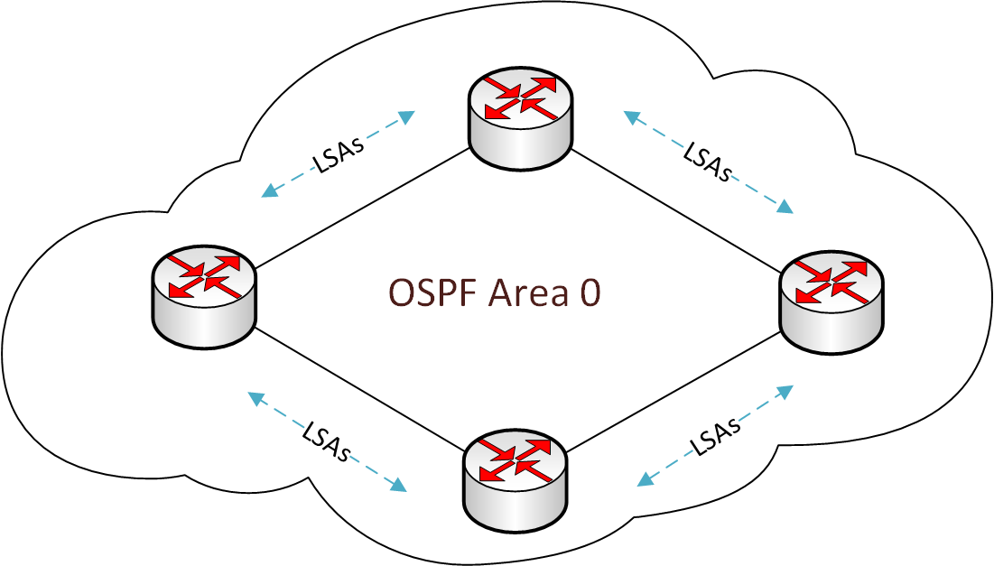
What is OSPF?
Open Shortest Path First (OSPF) is a link-state Interior Gateway Protocol (IGP)
IGPs are used to exchange routing information within a single autonomous system or administrative domain
The default preference of internal OSPF routes is 10
OSPF organizes routers/destinations into areas for manageability and computation optimization

Slide 4
What is a link-state protocol?
Link-state routing protocols maintain a database of all routers, destinations and their connecting links within a region of the network
Each router performs its own calculation to determine the shortest path through the network for every destination
The link-state database (LSDB) on each router within the region of the network must be identical for the routing to work correctly
The LSDB is populated with the contents of Link-State Advertisements (LSAs) that are flooded through the network by each router participating in OSPF

